Slide 1
Master-Thesis Methodical Approach for Analyzing Process Parameters and Optimizing Boundary Conditions in Mutli-Axis Robot Programs
Status Update: Week 03
16.10.2023 – 22.10.2023
Jan Nalivaika

Slide 2
Recap : Week_02
VIP:
Aufgabenstellung
Anmeldung
Vereinbarung
Exposee
Not VIP
NX
Table of Content

Slide 3
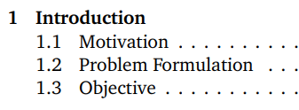
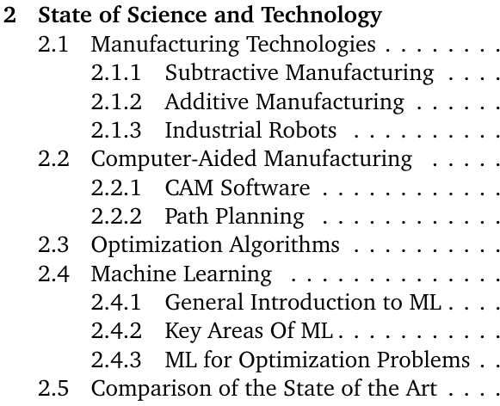
Table of Content

Slide 4
Idea
Robot
Path
Simulation
Testing
on system
Manufacturing
Part
Optimal Parameters
Extract Data
(Predictions)
Extract Physical Values
Comparison
Analysis

Slide 5
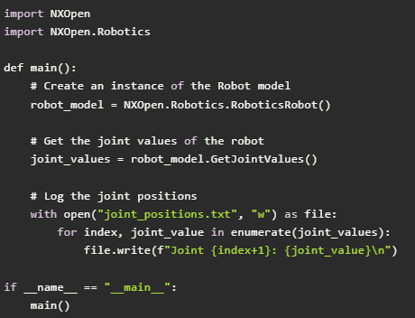
Idea – Evaluation of a toolpath
Count direction changes
Siemens NX
Toolpath
Get joint movement
Get Acceleration
Get Jerk
Calculate extension
Calculate Stiffness
Calculate Energy use
Check If close to singularity

Slide 6
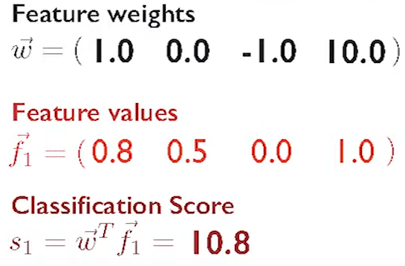
Step 1 - Analysis
Goal:
Return a Value
Analyze one user defined toolpath
Or
Create Database:
Set random parameter + calculate score
Part
Robot rules
Toolpath
P1: weight x
P2: weight x
Score
P3: weight x
P4: weight x
ML for score calculation ?
Probably not

Slide 7

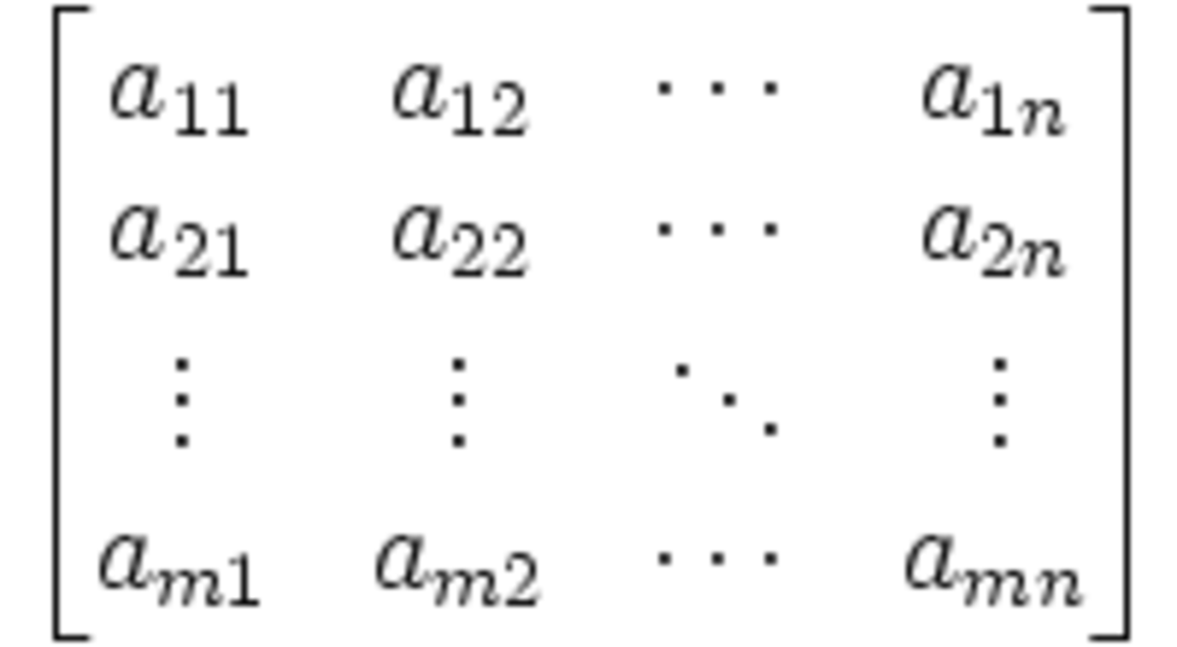
ML: Regression Problem
Goal:
Give a suggestion
Image → Label
Is ML in this case
just a form
of remembering ??
If we can calculate
the best params
in the fist place,
We do not need
ML
Except if ML can do
It fast and Can
Actually learn
Something
Win: efficiency
Loss: Precision
Only valid for a specific cell
→
Rain: 99,8%
How to find these values for training ????
Single output
or
Multi output
Importance of Parameter 1 | Importance of Parameter 4 | Importance of Parameter 7
Importance of Parameter 2 | Importance of Parameter 5 | Importance of Parameter 8
Importance of Parameter 3 | Importance of Parameter 6 | Importance of Parameter 9
→
C-Axis: 31deg.
→
A-Axis: 0 deg.
B-Axis: 55 deg.
C-Axis: 10 deg.

Slide 8
Step 3: Combinatorial optimization problem
Goal:
Give a most optimal
suggestion
Variable:
- Axis A
- Axis B
- Axis C
Domain A
Domain B
Domain C
Constrains;
A+B < 3
C > 30
Cost function:
Cost = f(A,B,C)
Brute Force Approach
BUT: in our case the constraints are not fixed
Dependent on part and manually set constraints

Slide 9
Problem: To much variability
Can Change
Are Changed
Machine
Part
Main Loop
Every change in Part
or Machine will
require a recompute
Robot rules
Path
Score
Goal: Change in Weights
Does NOT require a recompute
Weights
BUT……

Slide 10
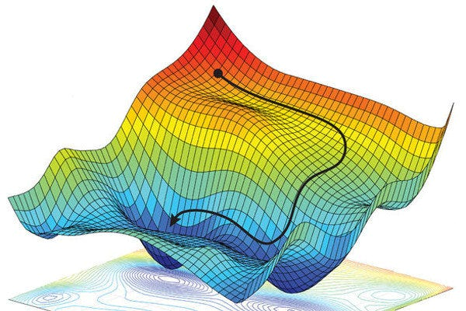
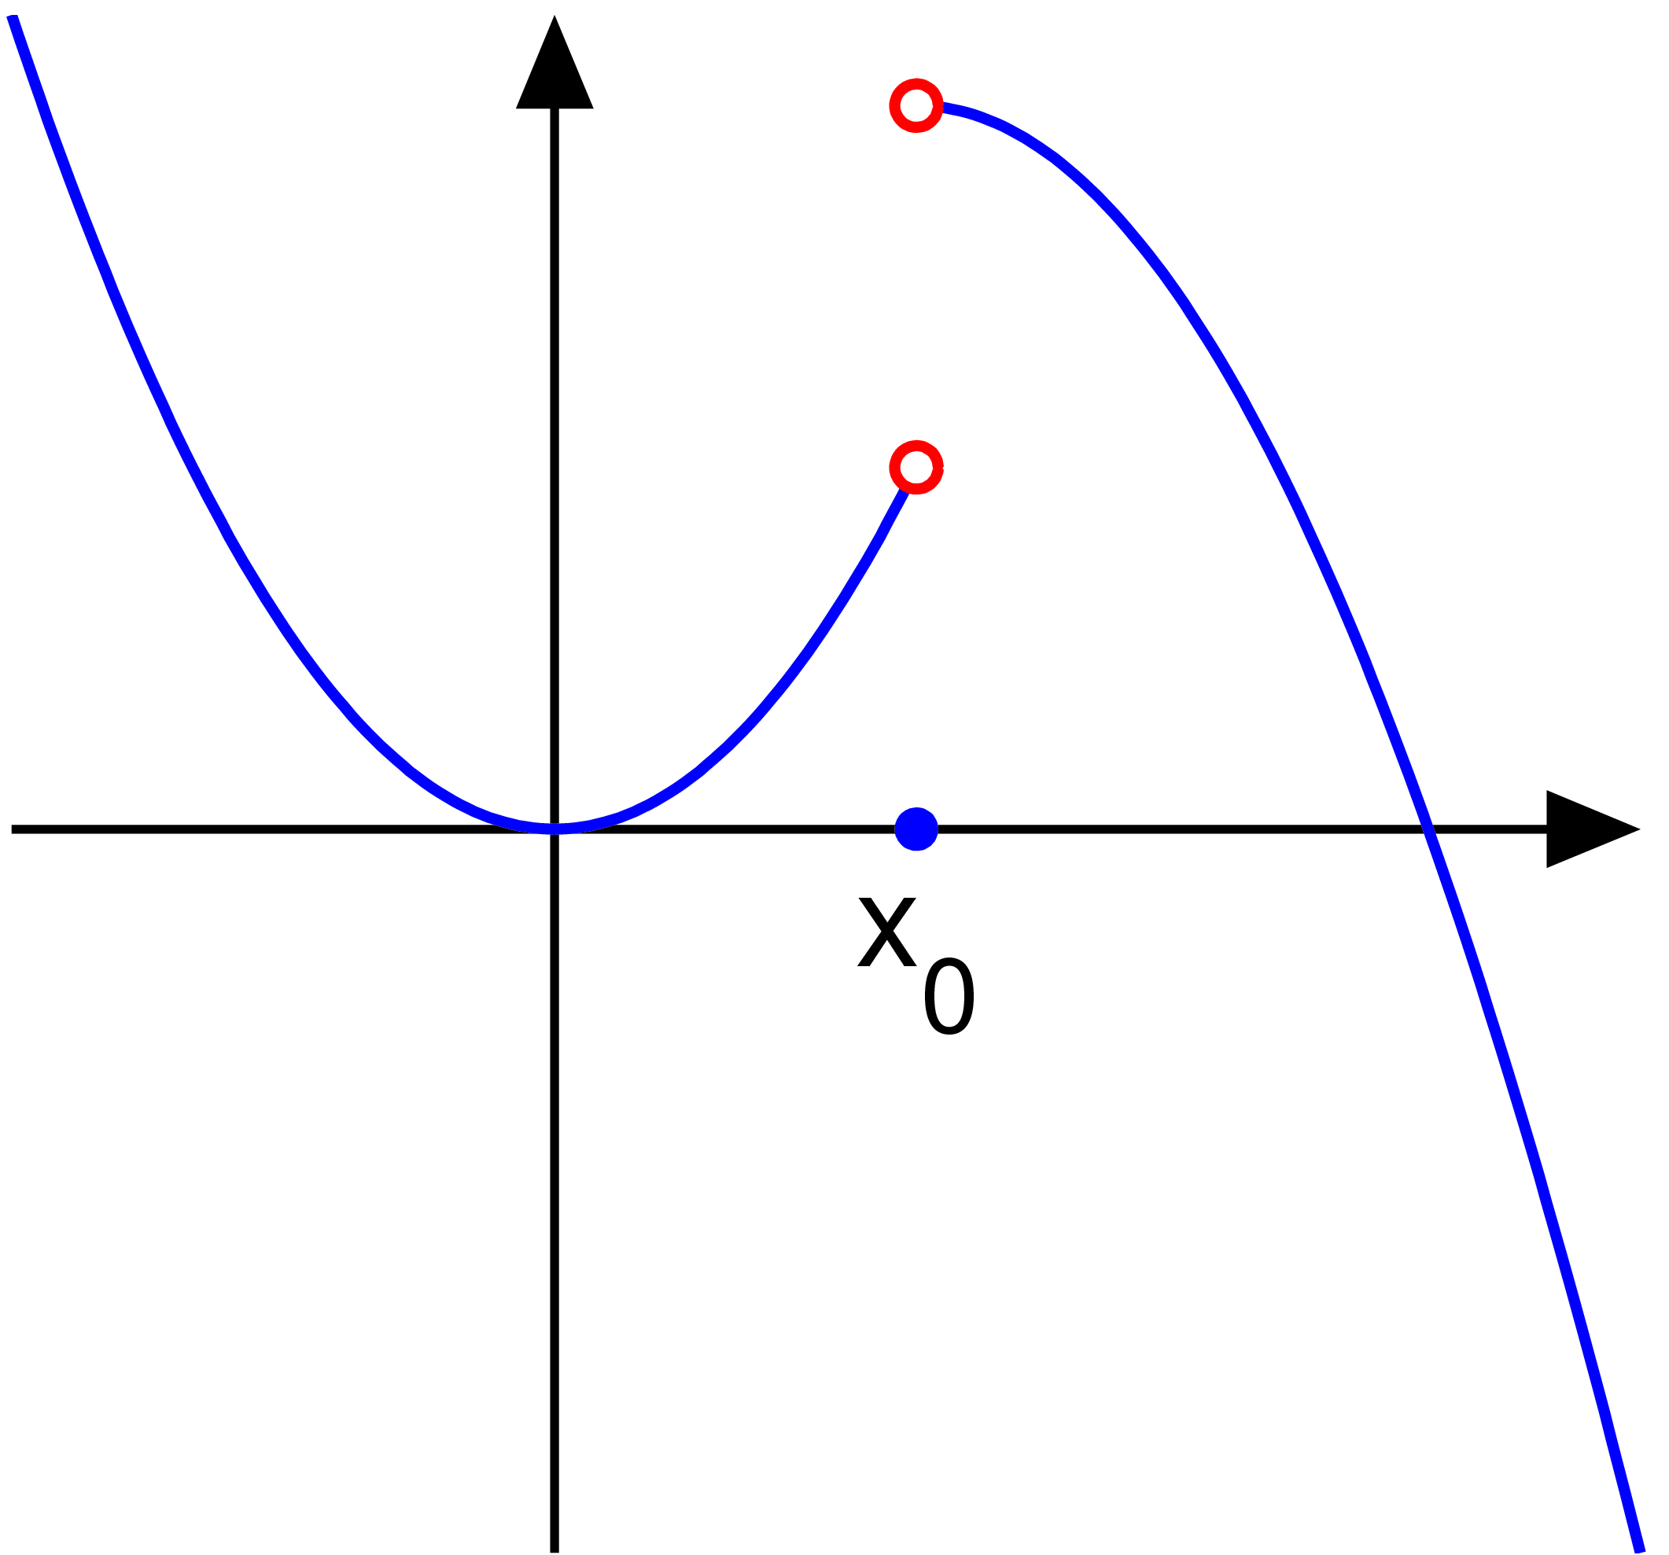
Problem: Is this a Convex problem? Is it continuous ?
…… Every Weight change generates a new surface → Recompute always necessary ? (How similar are Hyperplanes ?)
BUT…… if recompute fast enough, that’s very good
Axis of surface == Robot Rules Parameter
Question: How high is the resolution of the hyperplane?
“Stochastic gradient descent”

Slide 11
Contact
Jan Nalivaika (TUM) Student Otto-Hahn-Ring 6
81739 Munich, Germany
Phone +49 163 7180148
E-mail jan.nalivaika.ext@siemens.com nalivaika@outlook.de
Marius Breuer (Siemens AG)
Supervisor Otto-Hahn-Ring 6
81739 Munich, Germany
Phone +49 (172) 8396287
E-mail marius.breuer@siemens.com
Ludwig Siebert (TUM-IBW)
Supervisor Boltzmannstr. 15
85748 Garching at Munich
Phone +49 (89) 289 – 15578
E-mail ludwig.siebert@iwb.tum.de

